Slide 1
For Live Session #5
Javier Saldana

Slide 2
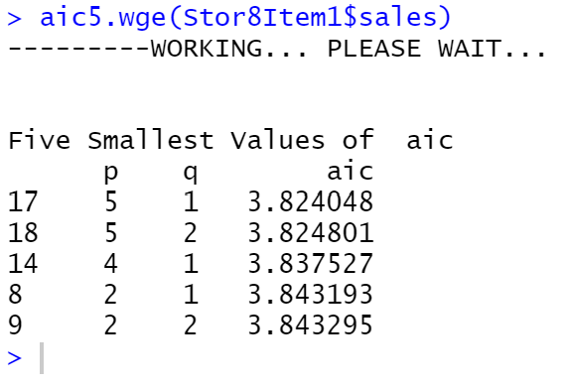
Use Aic5 to assess the use of ARMA models in the Walmart data.
Based on the output, we can see the ideal model (with regards to aic) is an ARMA (5,1) model. In fact, all top 5 models are ARMA models.

Slide 3

Find ρ1 for the following model by hand. X_t = a_t –.8a_t-1 + .5a_t–2
$ρ_{1}=\frac{−θ_{1}+θ_{1}θ_{2}}{1+θ_{1}^{2}+θ_{2}^{2}}$
$ρ_{1}=\frac{0.8+(0.8 × −0.5)}{1+{0.8}^{2}−{0.5}^{2}}$
$ρ_{1}=\frac{0.8+0.3}{1+0.64+0.25}$
$ρ_{1}=\frac{1.1}{1.89}=0.582$

Slide 4

Represent the model as a GLP.
$X_{t}=μ+a_{t}+θ_{1}a_{t−1}+θ_{2}a_{t−2}$
Mean is zero so…
$X_{t}=a_{t}−0.8a_{t−1}+0.5a_{t−2}$
Does this mean model was already in GLP format?

Slide 5
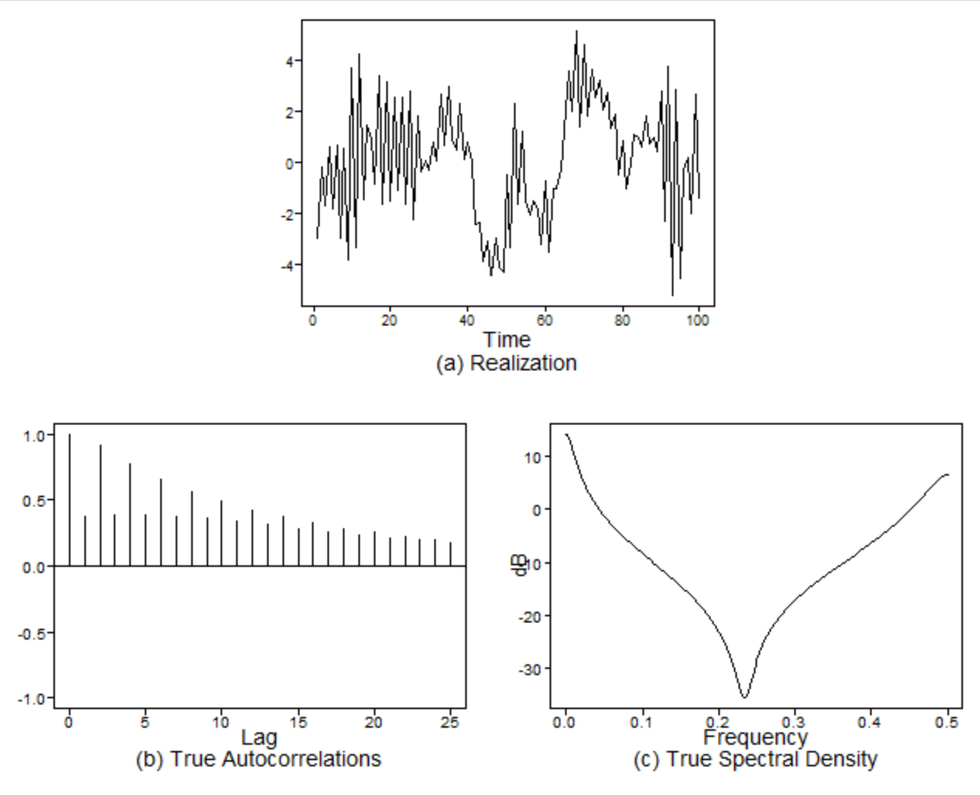
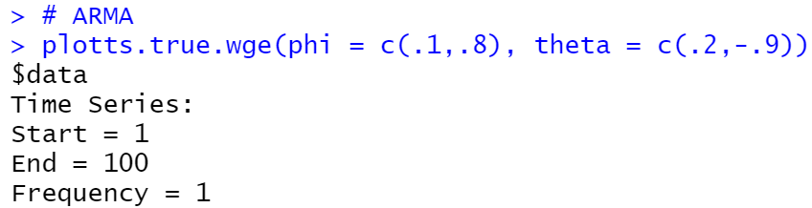
Generate a realizations from an ARMA model. You pick p and q. Include the ACF and spectral density.

Slide 6
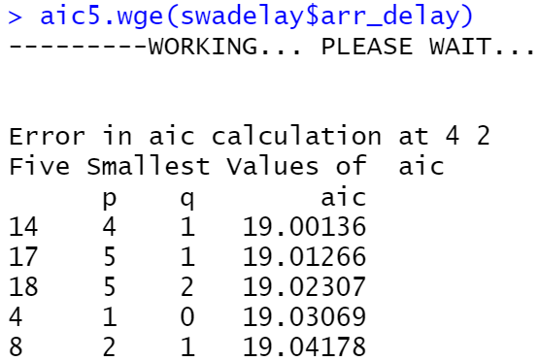
Use AIC 5 to identify the top five quality models with respect to AIC for the cancelled flight data from the SWADelay.csv data set (column: arr_cancelled). Comment on which are AR, MA, and ARMA.

Slide 7
Key Takeaways & Questions
My key takeaway from this lesson was the blending of AR and MA in order to improve the model. Some of the pieces from prior lessons are coming together and are now making sense (such as the influence of absolute values in the factor output).
One question I had was the significance (or meaning) of the symbol Ψ and how that is different than the θ. In the beginning of the lesson, it seemed as if they were being replaced but then I noticed it come back when looking at the weights. Would they simply be the coefficients of the parameters? Also, in the code I noticed I was getting several ‘Error in aic calculate at 1 0’ and so on. Is this indicating there is an issue with the data or is it simply that the model isn’t stationary, therefore it won’t calculate? Thank you for your help. Its all coming together now!

